Slide 1

FOODIS
Food & Beverage LTD
Name: Debopriyo Sarkar Anik
Batch No: 48
Department: Geology and Mining
Date Of Submission: 09/12/2024

Slide 2

Overview
Foodies Foods & Beverages Ltd. is a leading food and beverage company headquartered in Dhaka, Bangladesh. Founded in 2005, the company has grown into one of the most recognized brands in the country, offering a wide range of locally-produced and processed food items and beverages. With a focus on high-quality, affordable, and accessible products, Foodies has become a household name across the country.

Slide 3

The ultimate goal of our company
GOAL
High-Quality Products
Innovation
Sustainability
Customer-Centric Approach
Market Leadership
Nutrition and Health

Slide 4
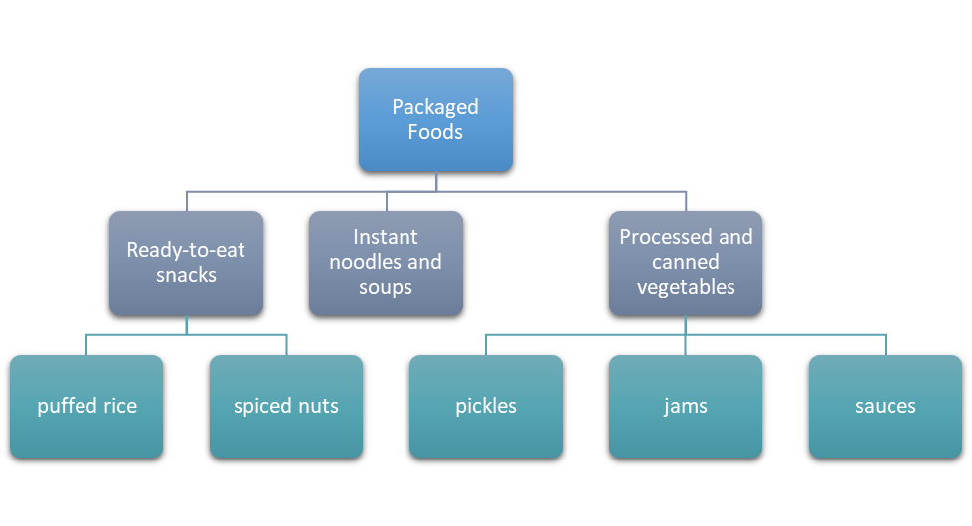
Products

Slide 5
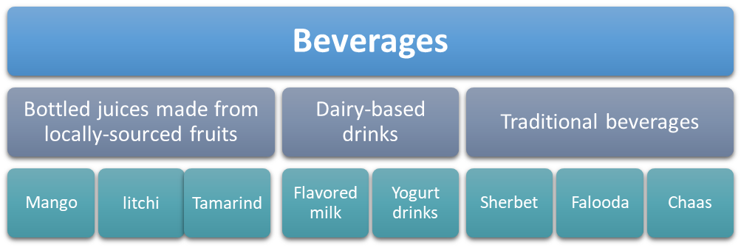
Products

Slide 6
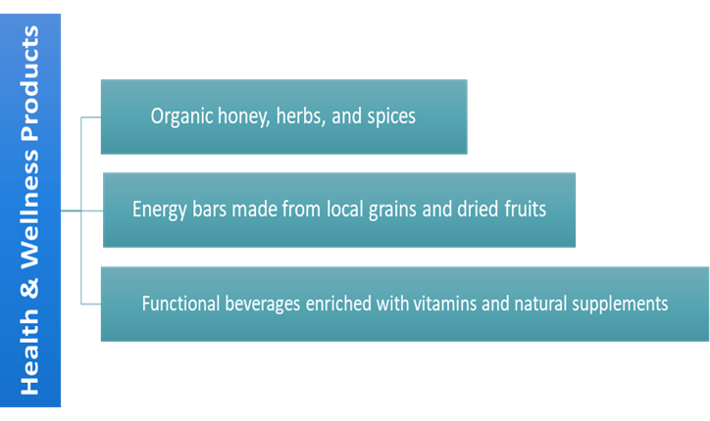
Products

Slide 7
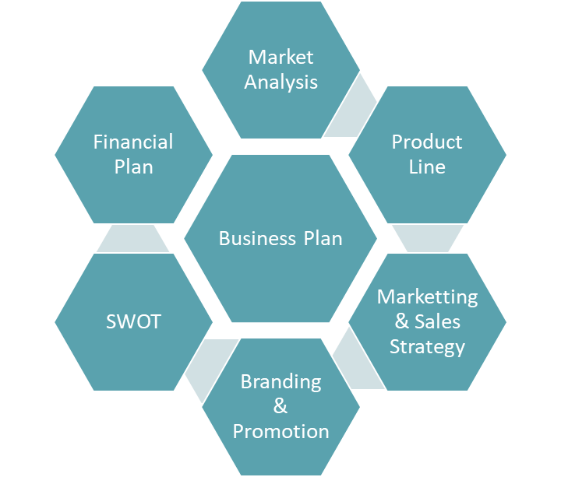
bUsiness Plan

Slide 8
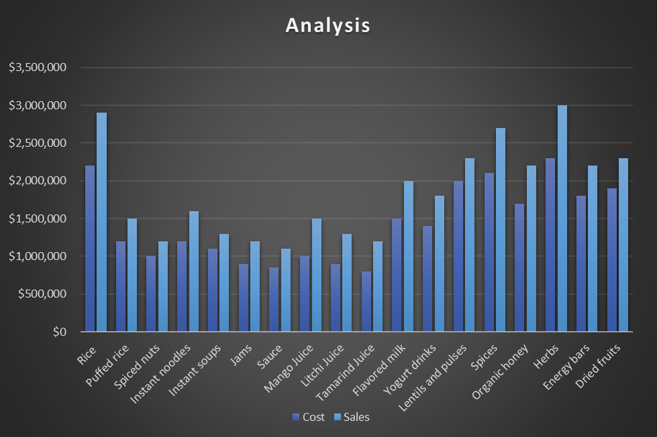
Analysis

Slide 9
Conclusion
In conclusion, Bengal Harvest Food and Beverage Ltd stands as a forward-thinking company dedicated to delivering high-quality, nutritious, and flavorful food and beverage products. With a strong focus on innovation and sustainability, the company aims to meet the evolving consumer demand for healthy choices while maintaining a commitment to customer satisfaction. Bengal Harvest strives to be a leader in the industry by prioritizing product excellence and ethical practices, ensuring long-term growth and positive impact on both consumers and the environment. Bengal Harvest Food and Beverage Ltd. is well-positioned to capitalize on the growing demand for nutritious, sustainable, and flavorful food and beverage products. With a focus on innovation, customer satisfaction, and eco-friendly practices, the company aims to become a leader in the industry, expanding both locally and globally while maintaining its commitment to health and sustainability.

Slide 10
Thank you

